Slide 1
CODINGRAD
LINUX

Slide 2
In Linux, file permissions are a set of rules that determine who can access, modify, or execute a file or directory.
These permissions help protect the system from unauthorized access and ensure that users can only perform actions on files.
File permissions are represented by a combination of letters and symbols in Linux. The most common representation is known as the "octal notation" or "numeric mode," which uses three digits to represent the permissions for the owner, group, and others, respectively.

Slide 3
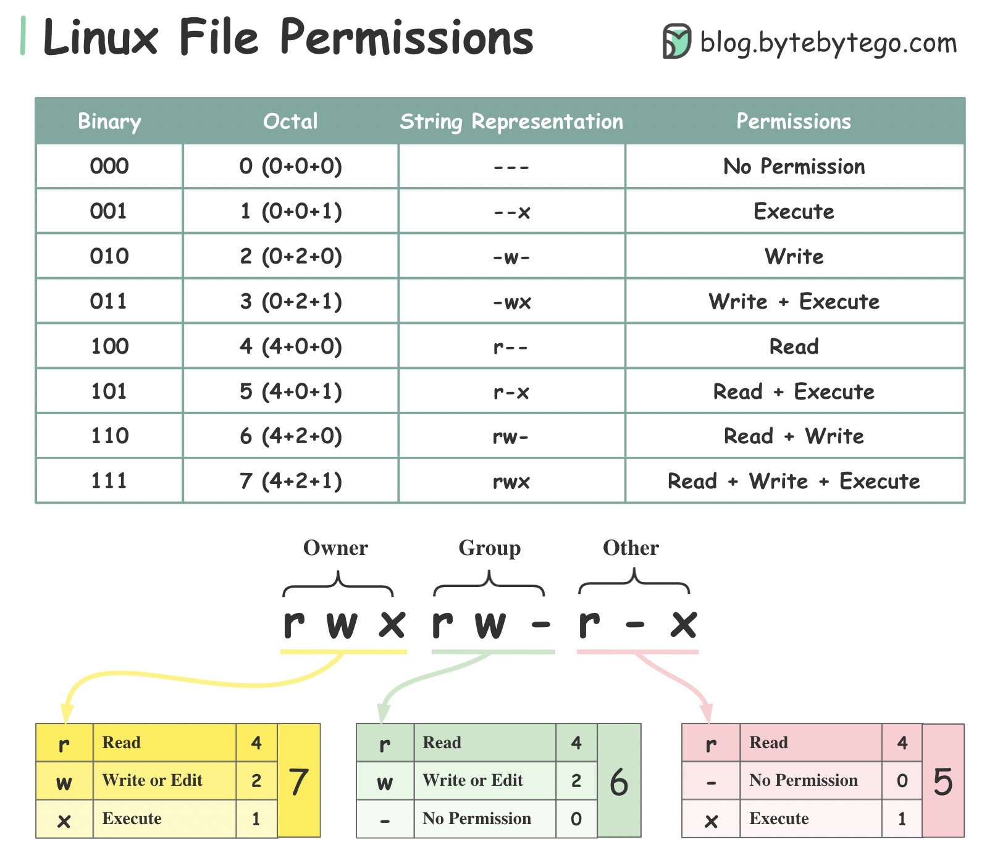
Linux-file creation:

Slide 4


